Slide 1
Intro to data science
Bishoy George
Ahmed wael
Menna elminshawy
Radwa belal
Nada ahmed

Slide 2
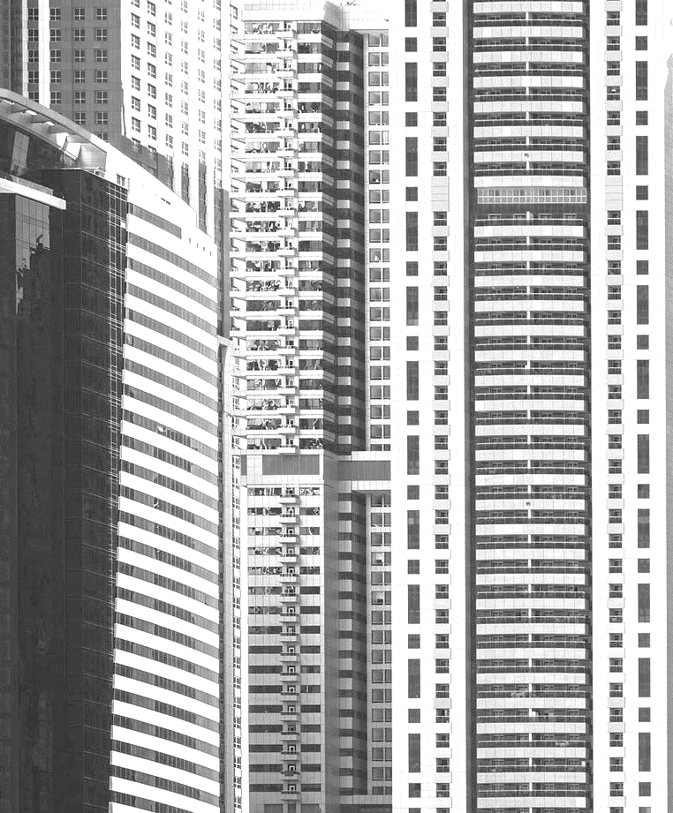

AGENDA
Data Cleaning
Data visualization
Data modeling
K mean
regression
random forest

Slide 3

INTRO
We have three data sets:
Sales
Weather
Fuel price

Slide 4
Data cleaning

Slide 5
Sales (check nans and duplicates and negatives)
 | store | category | Date | Weekly sales
1 | Nan | 1 | 2/5/2012 | 5.0
2 | 1 | 2 | 5/5/2015 | 3.0
3 | 5 | 3 | 6/6/2019 | 2.8
4 | 6 | 4 | 8/8/2017 | 3.0

Slide 6
Data visualization

Slide 7
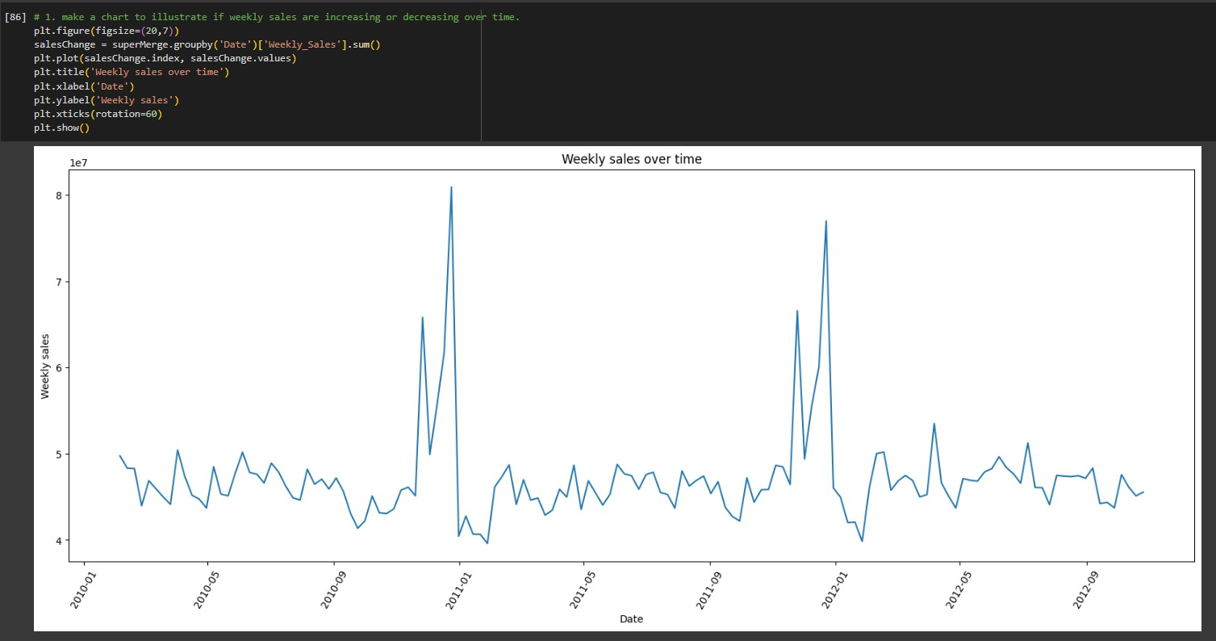
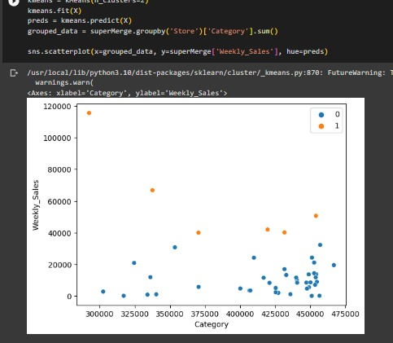
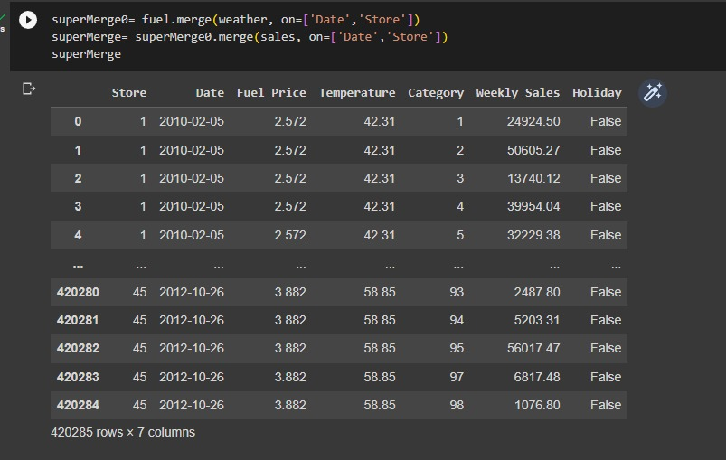
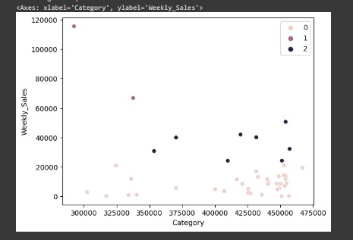
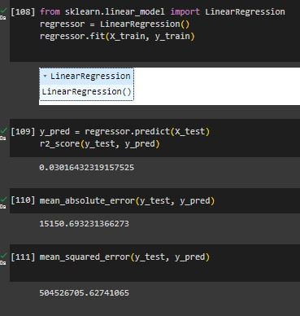
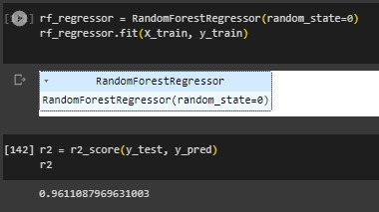

Slide 8
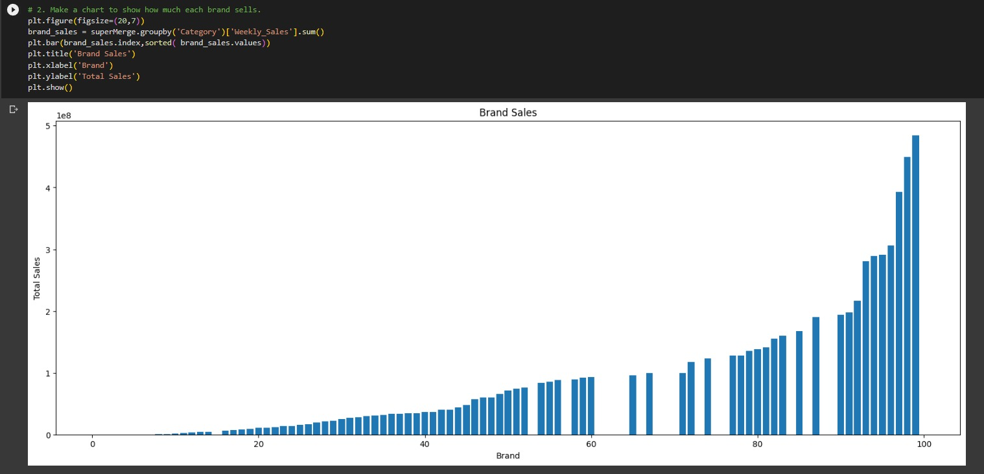

Slide 9
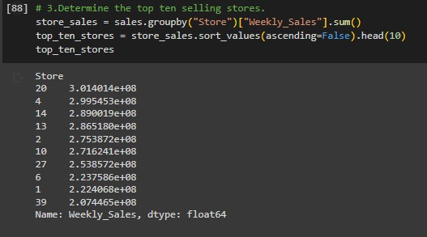

Slide 10
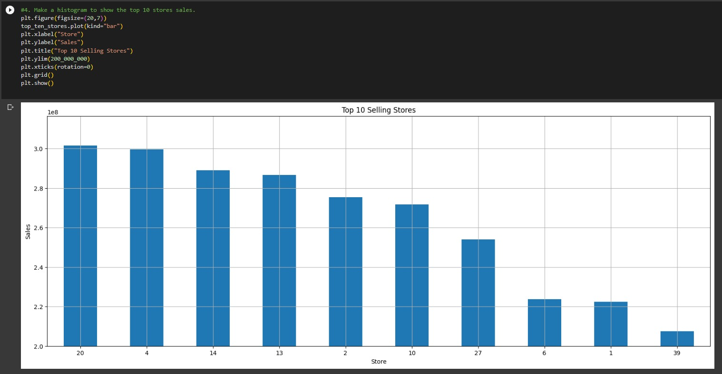

Slide 11
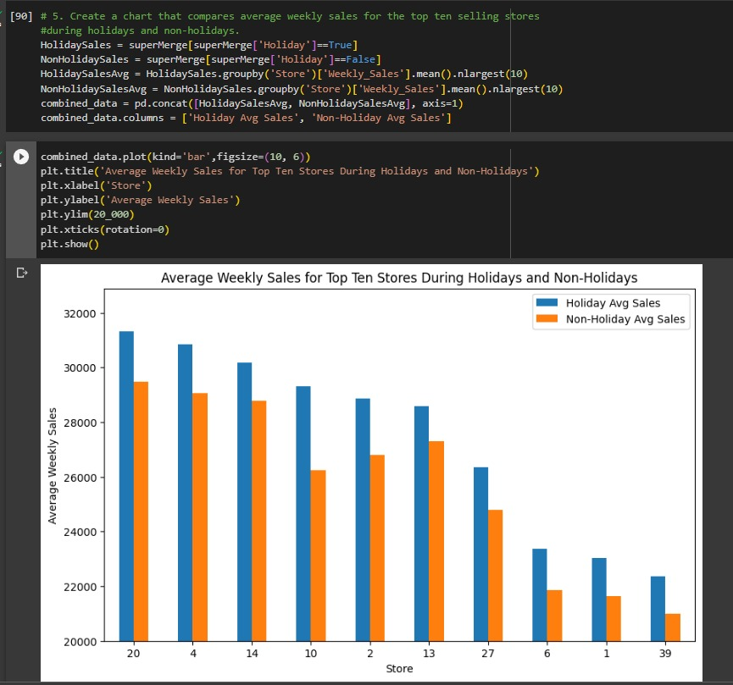

Slide 12
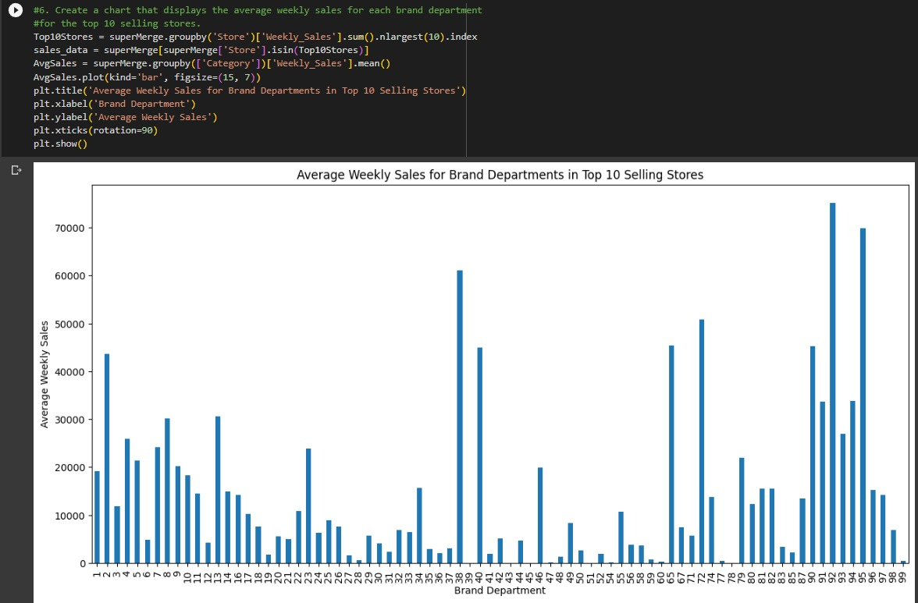

Slide 13
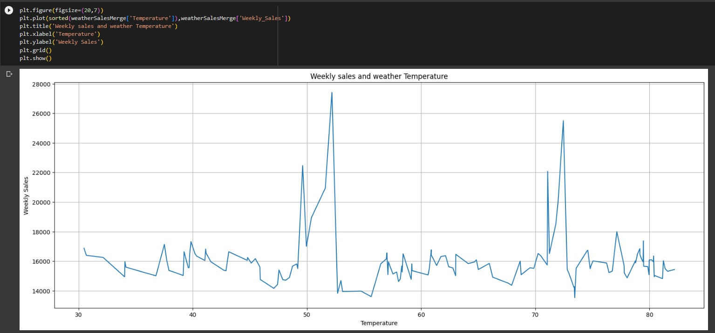

Slide 14
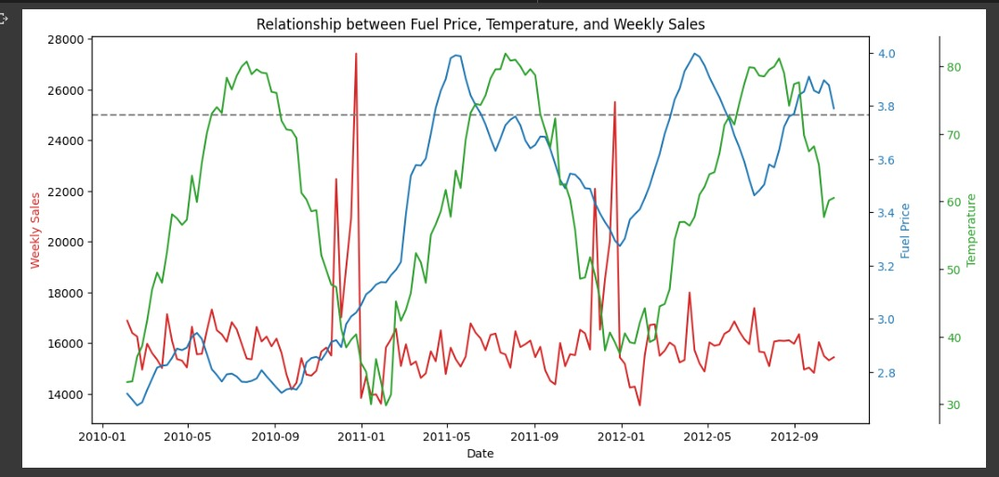

Slide 15
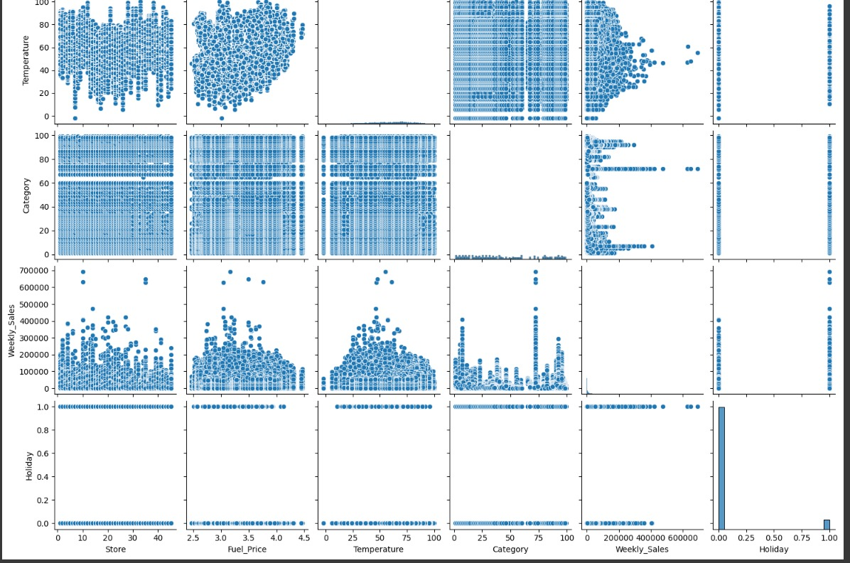
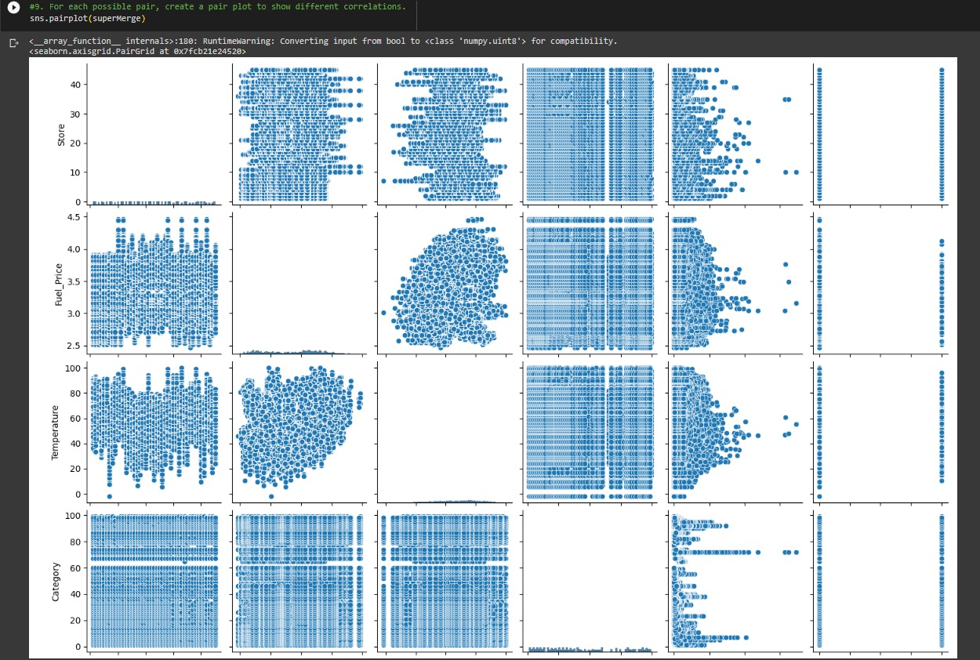

Slide 16

Modeling
We will Discuss the modeling part directly from the code for better understanding ☺

Slide 17
THANK YOU
Bishoy George
Ahmed Wael
Menna El minshawy
Radwa Belal
Nada Ahmed

